Slide 1
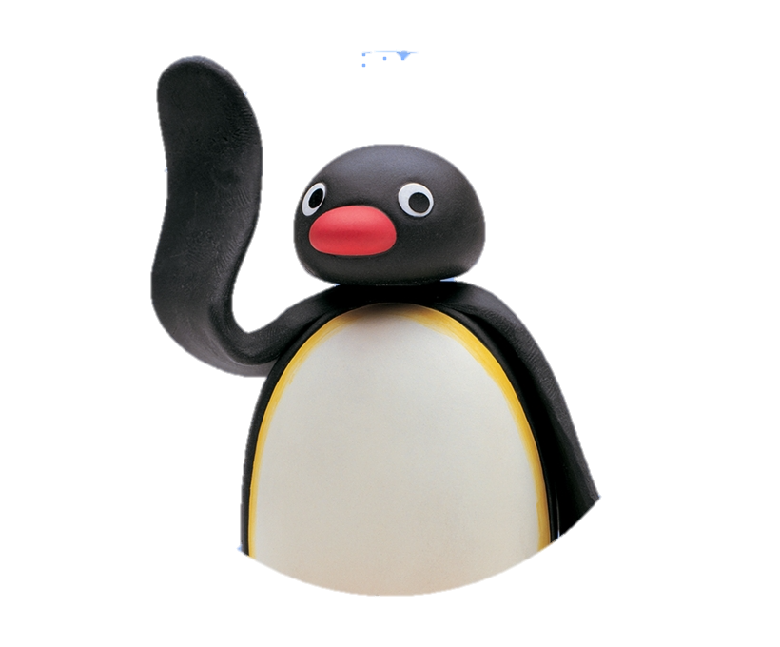
The Rolling Penguins Beatrice Seibert – Stefano Ferrari — Vincent Brunner
INTERACTION PROTOTYPING — FINAL PRESENTATION
Winter Semester 2021/2022
www.sumikai.com
Notes:
Person 1 HARRY

Slide 2



Rolling Penguins
Beatrice Seibert
Stefano Ferrari
Vincent Brunner
Notes:
Person 1

Slide 3
AGENDA
Introduction
Process & Development Stages
Final Prototype
Evaluation Results
Discussion & Conclusion
Notes:
Person 1

Slide 4
Content
Methods: Human-Centered Design Process (ISO 9241-210) with prototype 4 stages, UML Diagrams…
Results: Insights from evaluation and how we adjusted our screens
References: ➔ APA 6th / 7th citation guideline
Tools: Paper, Miro, Figma, HTML/Angular
Usability: Readability ➔ Use Calculation; SUS & UEQ; Heuristics; Material Design
Techniques: Front End & Back End Interplay

Slide 5
Content:
Einstieg und Agenda: How might we question; ​ Tonspur Mitbewerber anschauen​
Our Approach: Human-Centered Design Process 4min​
Our Way: show the 4 prototypes as pictures (alte Evaluation)​
Our Final Prototype: Frontend/Backend, Functions: 2min​
App Showcase: 4 min​
Our Final Evaluation: Hypotheses, SUS, UEQ: 4min​
—the end—
Notes:
Person 2
Person 1: 2mins

Slide 6
Introduction
Our Idea
IPP 2022
Notes:
Person 1

Slide 7
How might we?
Find present and future events based on the interests of the user.
Allow users to organize events, which they publish, feature, and promote in the app.
Notes:
Person 1

Slide 8
How might we?
Find present and future events based on the interests of for the user.
Allow users to organize public events, which can be then published and featured in the page.
How might we help people find events they are interested in?
Notes:
Person 1

Slide 9
PROCESS & DEVELOPMENT STAGES
Our Approach
IPP 2022
Notes:
Person 1

Slide 10
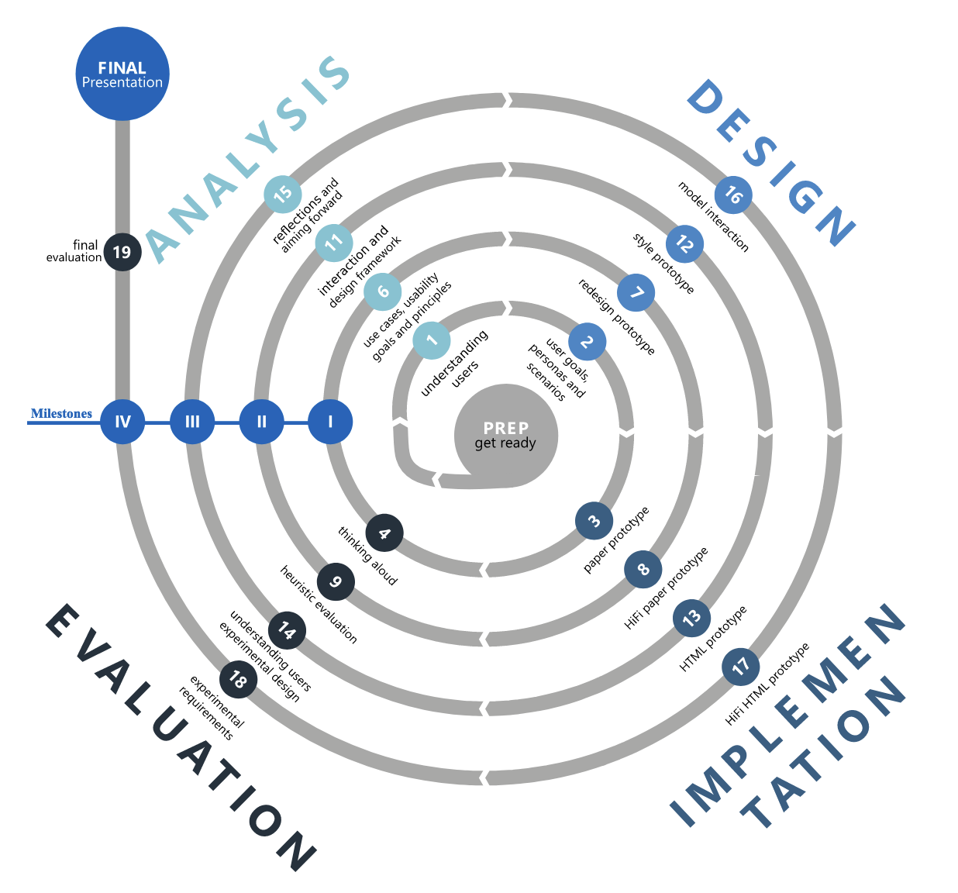
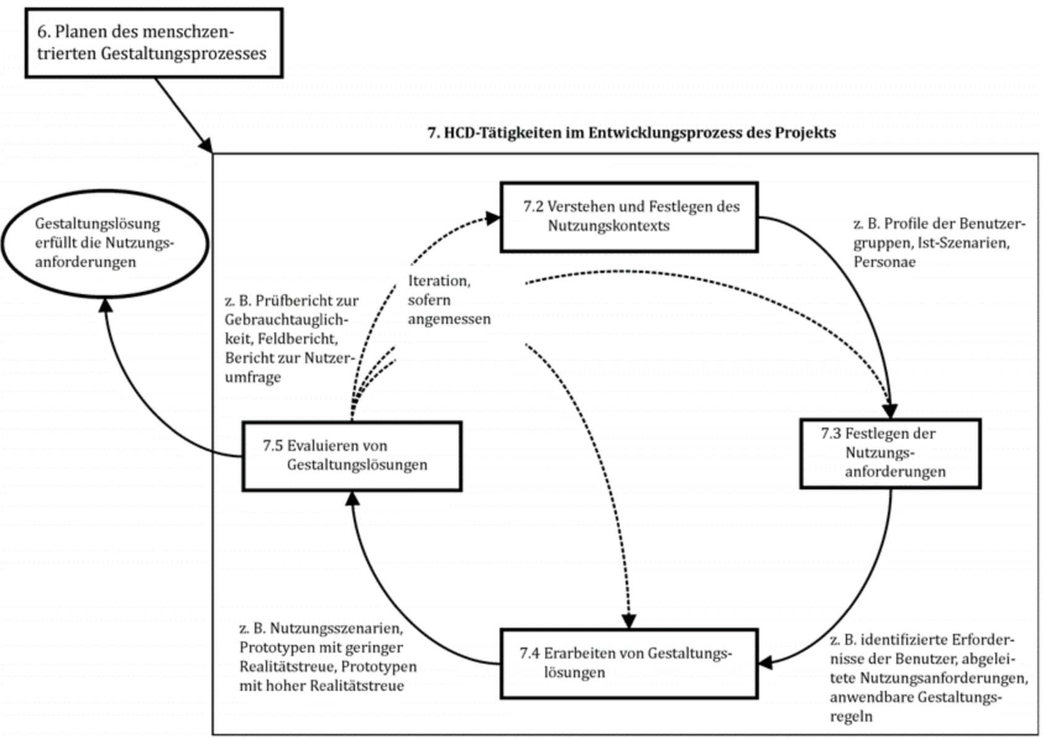
The process we followed
Process of IPP (InteractionPrototyping, 2020)
Human-Centered Design Process (ISO 9241 – 210:2019)
Notes:
Person 1

Slide 11
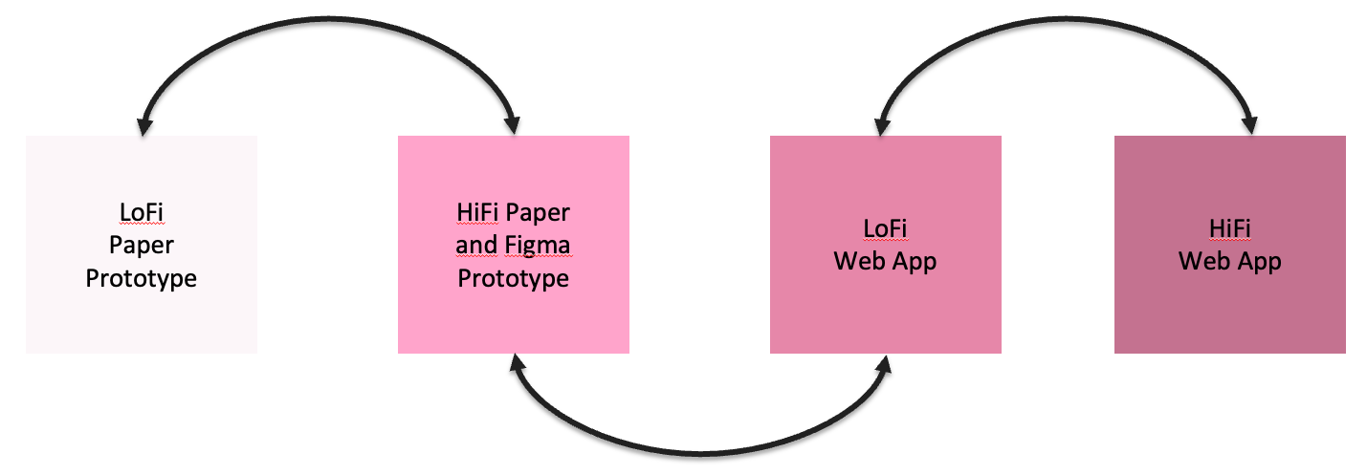
The process we followed
Prototype development in iterations
Process of IPP (InteractionPrototyping, 2020)
Human-Centered Design Process (ISO 9241 – 210:2019)
Notes:
Person 1

Slide 12
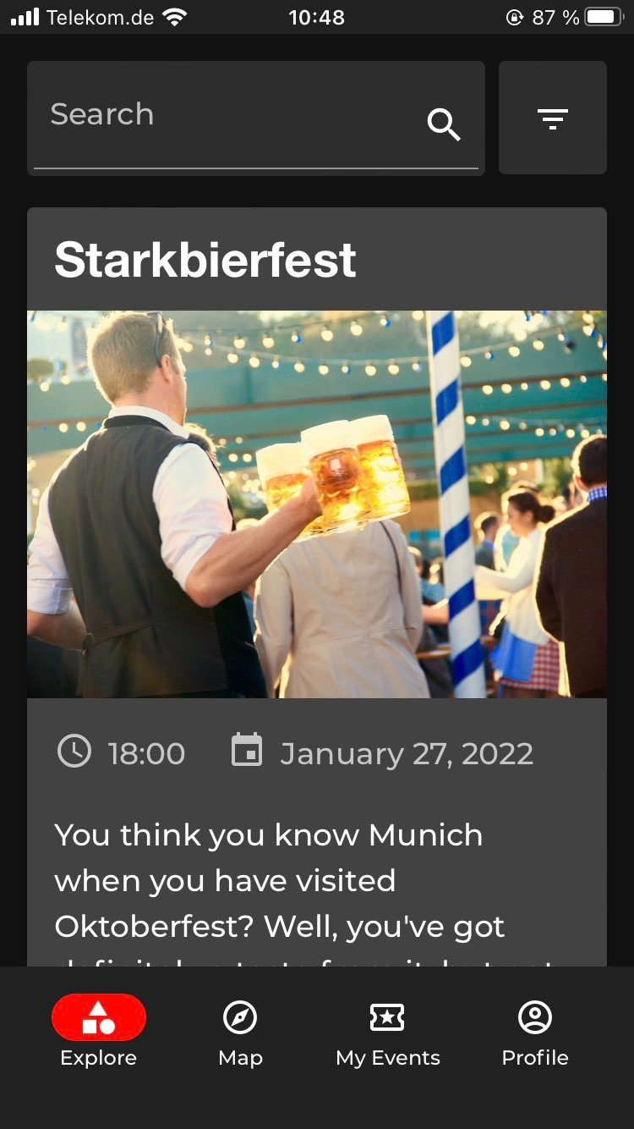
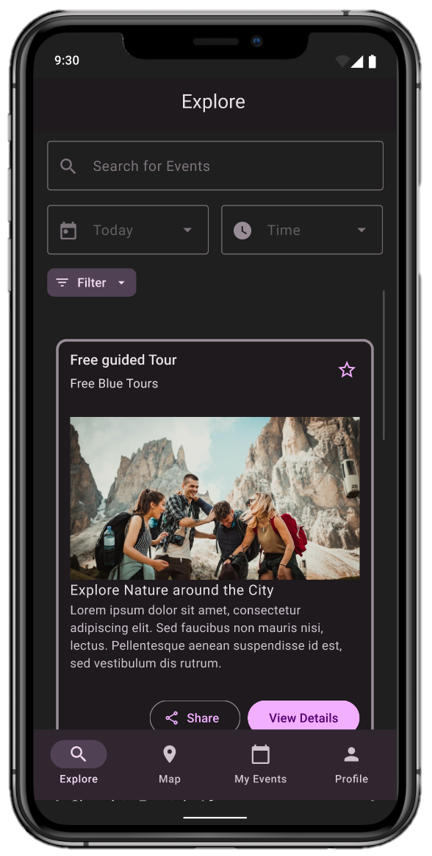
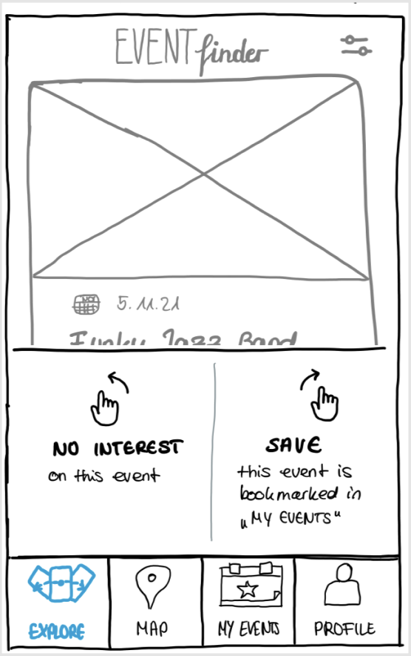
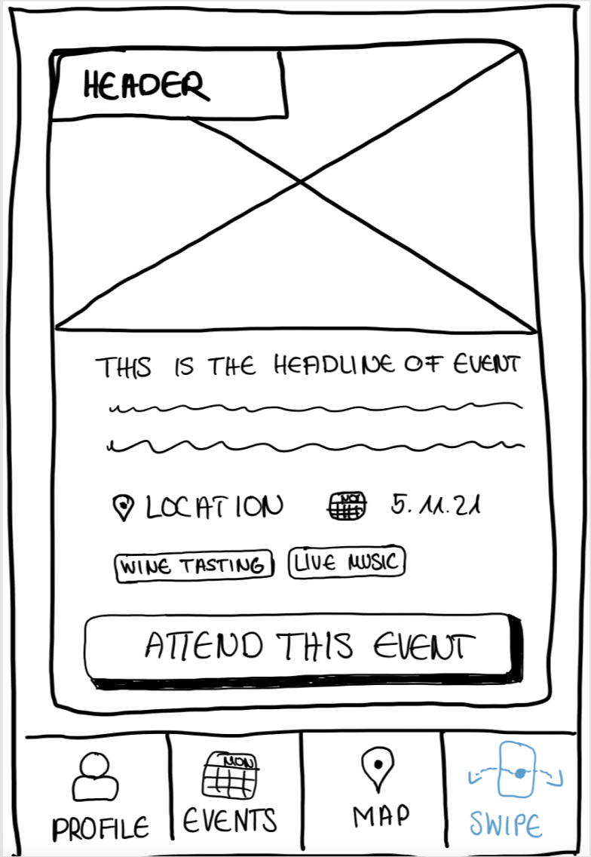



The Evolution of Event Finder App
Evaluation
Evaluation
Evaluation
Notes:
Person 1

Slide 13
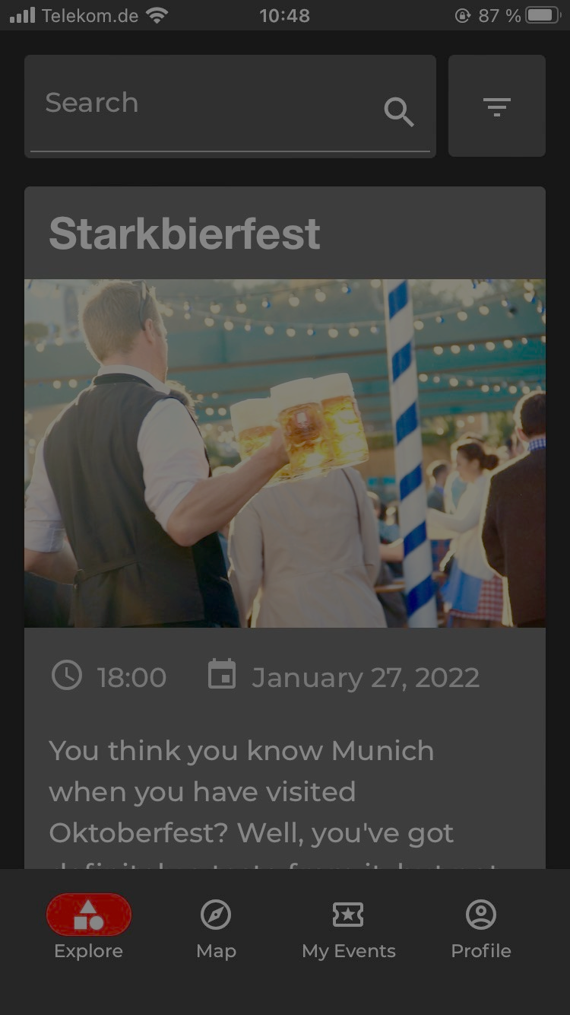
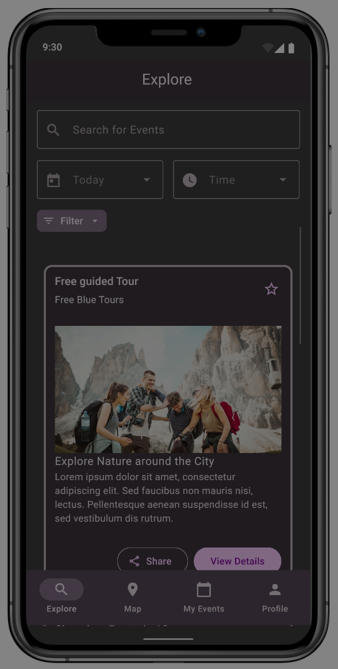
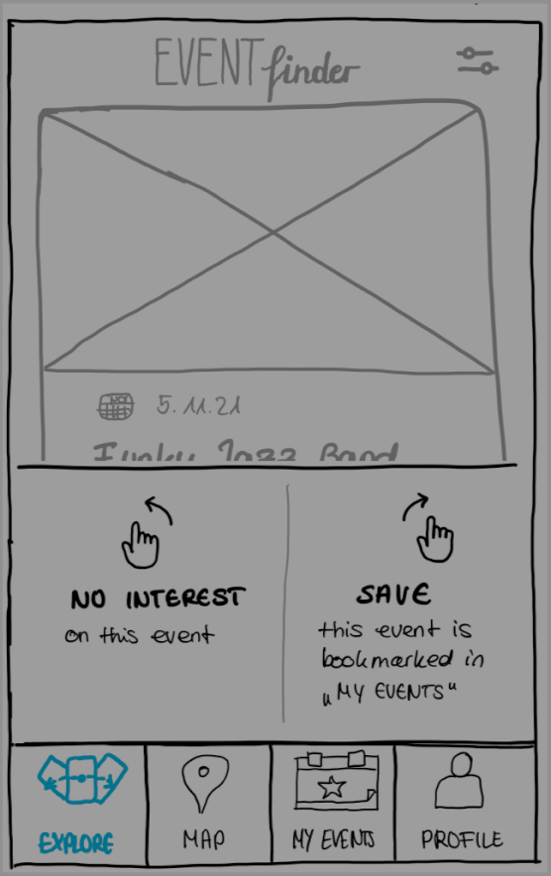
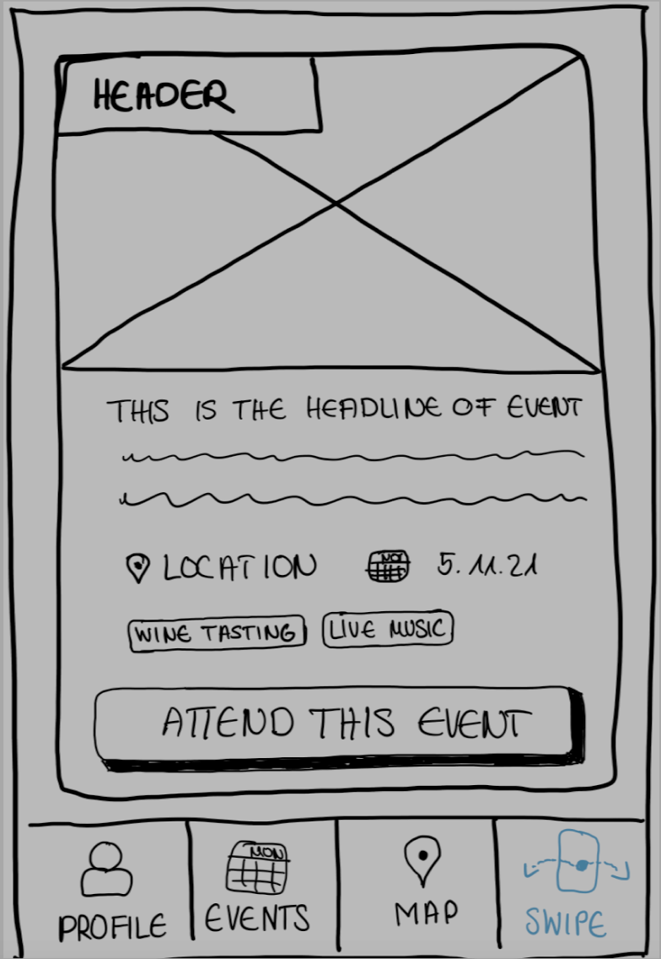




Iterative Improvements
Evaluation
Evaluation
Font Size
Usability Flaws
Design Change
Evaluation
Swiping Interaction
Information architecture
Notes:
Person 1

Slide 14
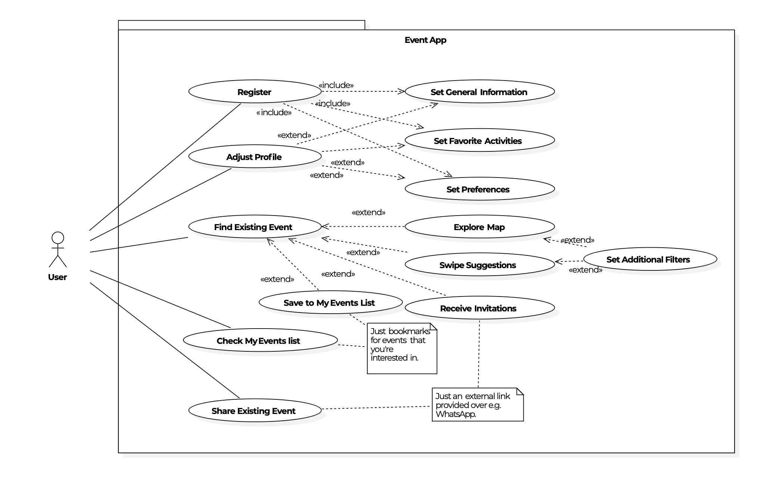
Initial Idea

Slide 15
Implemented in latest prototype
After Iteration 4
By Iteration 4

Slide 16
The Evolution of Event Finder
Evaluation
We designed...
Evaluation
We designed...
We considered...
Evaluation
We looked into...
We adjusted...
We learned...
We designed...
We designed...
Notes:
Person 1

Slide 17
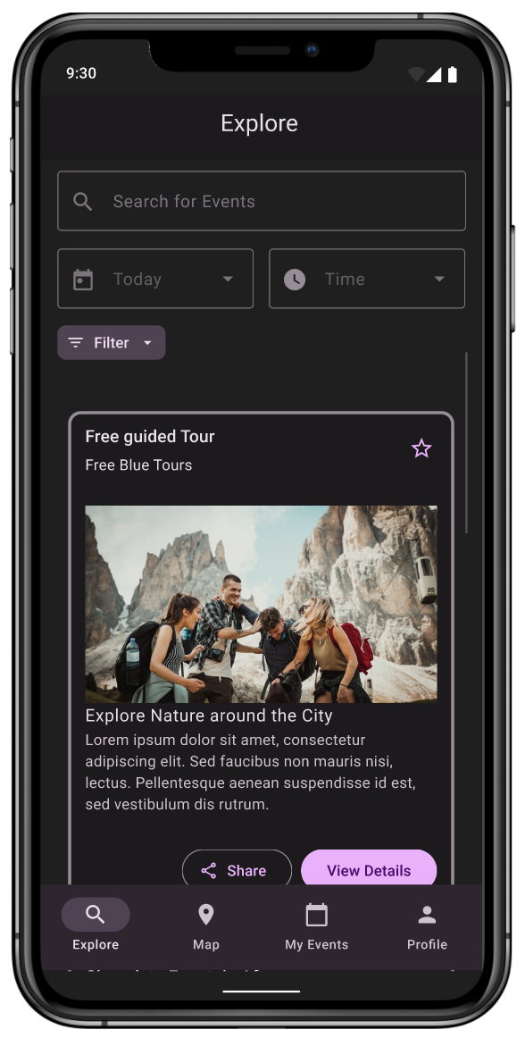


The Evolution of Event Finder
Evaluation
Evaluation
Implement Feedback
Evaluation
Implement Feedback
Implement Feedback
Notes:
Person 1

Slide 18
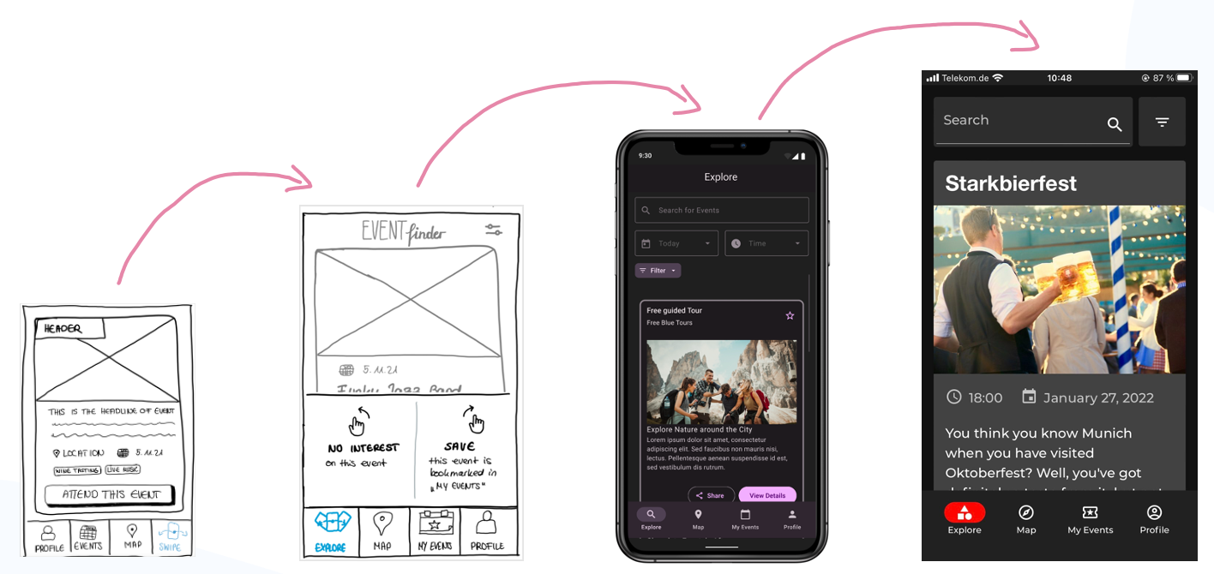



LoFi Paper Prototype
We looked into...
Young professional
Student
3 different Personas
Miro
Senior professional
We learned ...
Thinking aloud
Information Structure is partly misleading
Moderation of private events?
User Tasks
User Goals and Scenarios
Figma
Private vs. Professional events
Find right Event
Decide spontaneously
Wording Issues
Logic of Swipe Mode ?
Exploring events in the city
Users liked the available functions
Notes:
Person 1

Slide 19
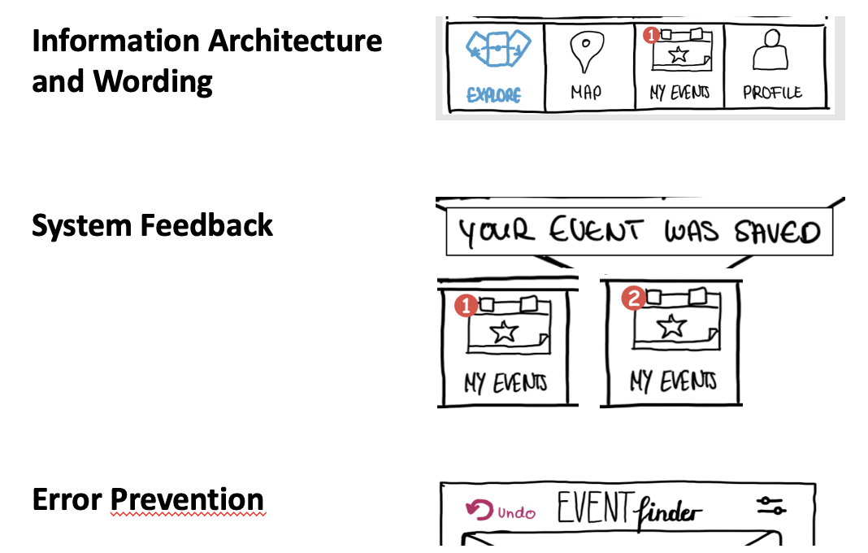
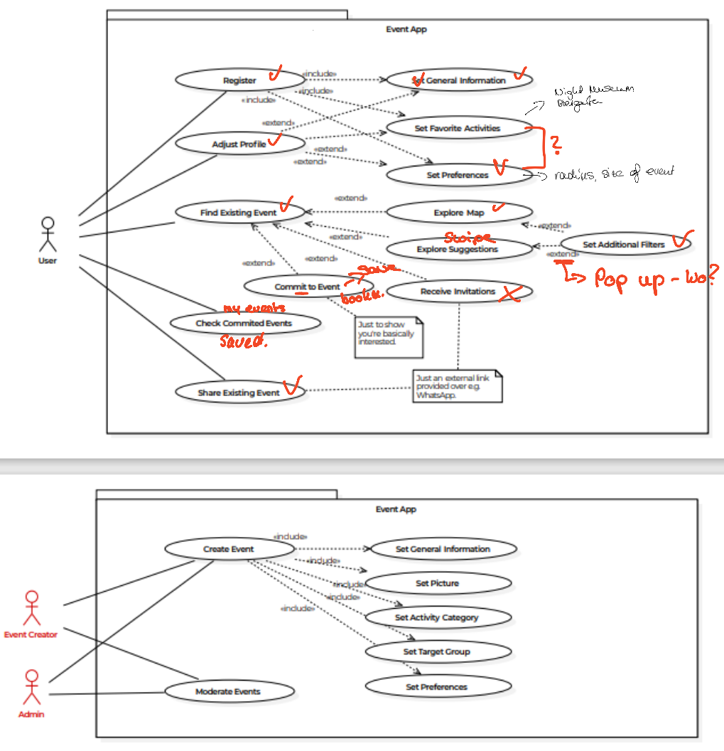
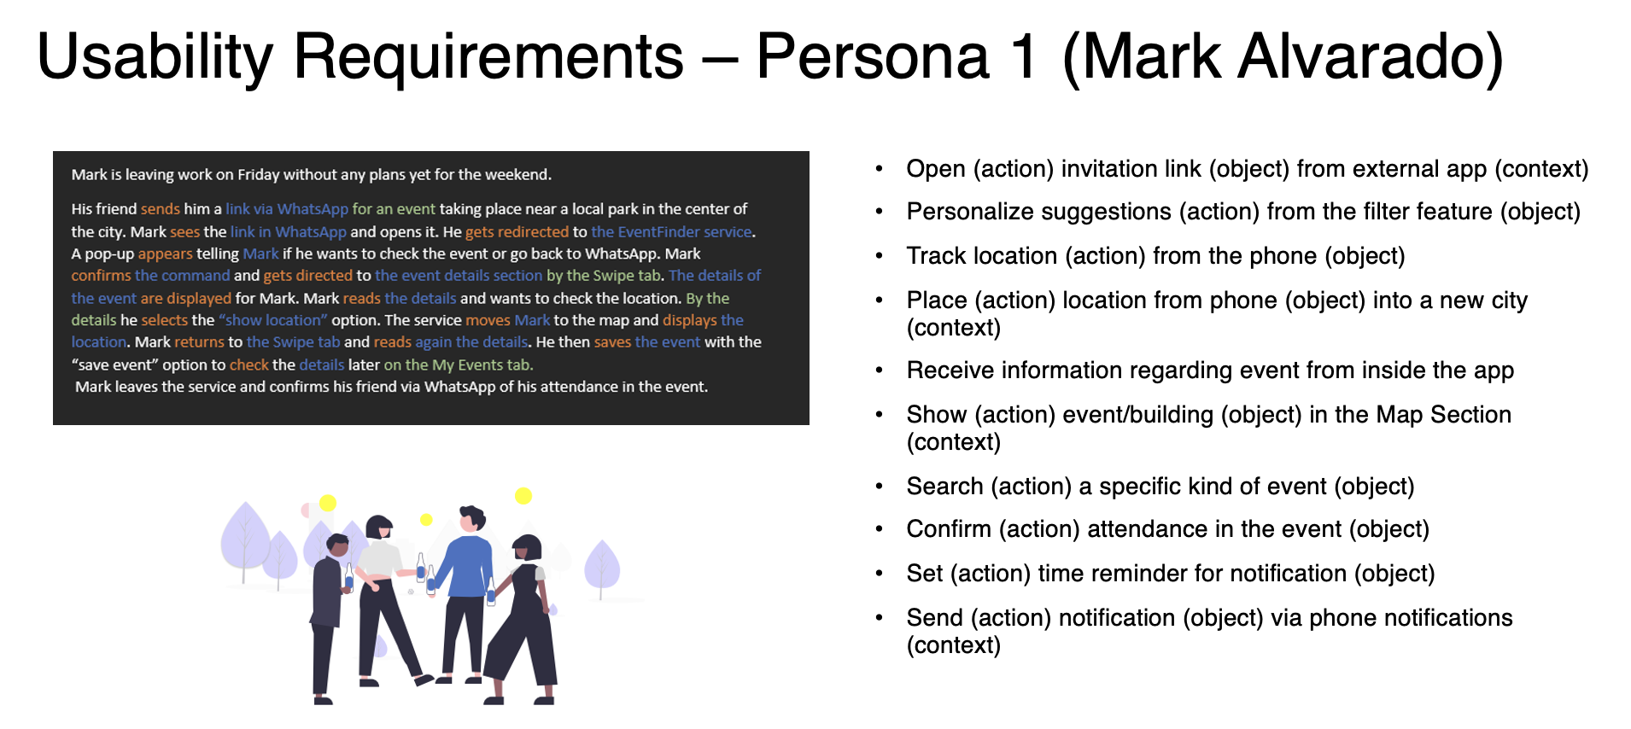
HiFi Paper Prototype
We considered...
Feedback Iteration 1
Usability Requirements
Heuristic Evaluation
UML Use Cases
Competitor and similar Apps
We adjusted...
Notes:
Person 1

Slide 20

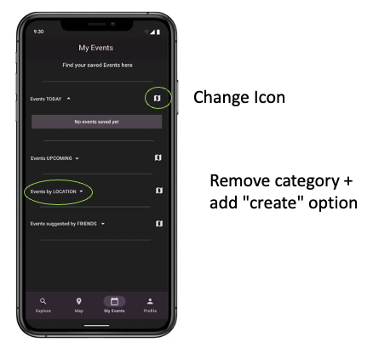
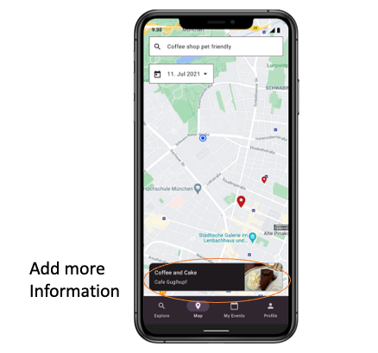
HiFi Prototype
We designed...
We changed...
User tested
Familiar to user
Intuitive UI
Assures readability and accessibility
Notes:
Person 1

Slide 21
The Evolution of Event Finder
Notes:
Person 1

Slide 22
The process we followed
LoFi
Paper
Prototype
HiFi Paper
and Figma Prototype
LoFi
Web App
HiFi
Web App
Notes:
Person 1

Slide 23
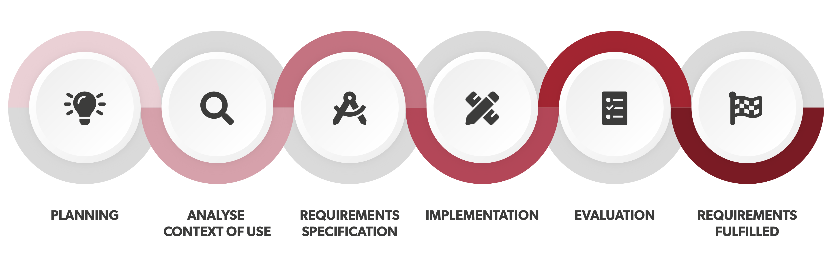
Following the Human-Centered Design (ISO 9241-210)
Notes:
Person 1

Slide 24
Event Finder
The App
IPP 2022
Notes:
Person 1

Slide 25





Technology
FRONT END
BACK END

Slide 26
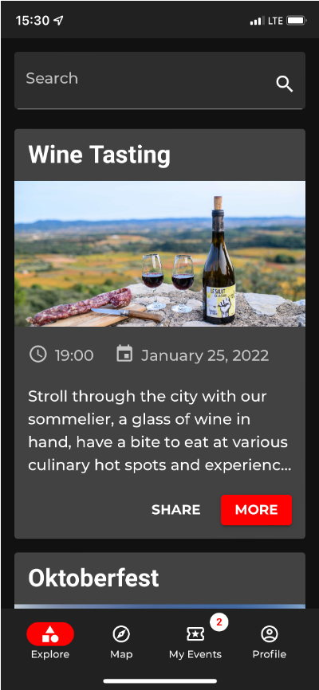
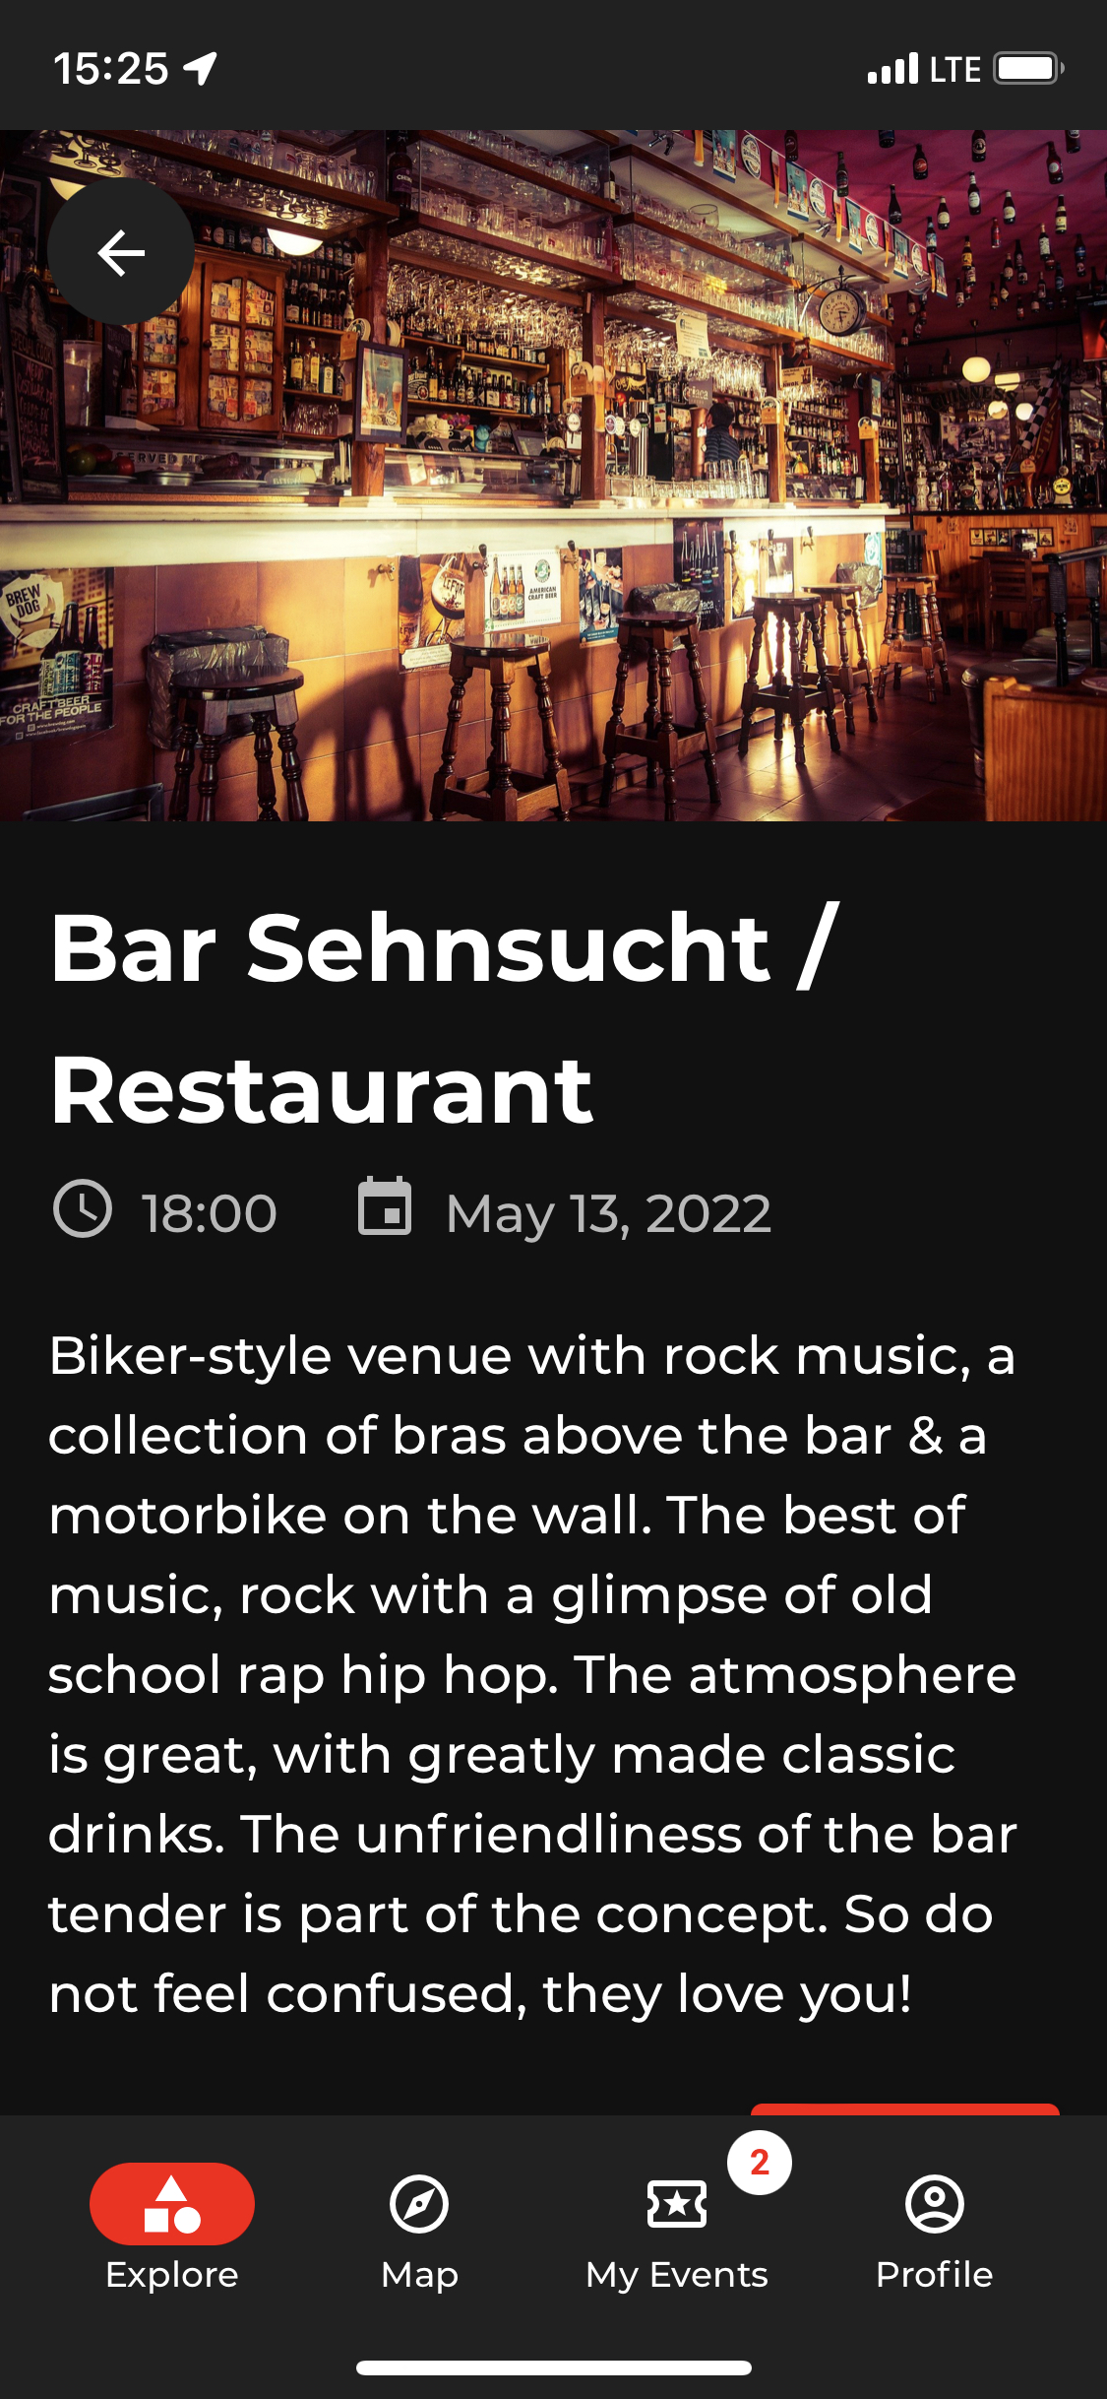
Showcase
https://interactionprototyping.github.io/WS2022_RollingPenguins/
Create your own account (password must be 8 chars long)
Have fun trying EventFinder out

Slide 27

Final Prototype
Final Prototype
Techniques: Frontend/Backend Interplay​
Functionality: Horizontal and vertical implementation, show by UML-Diagram
IPP 2022
Notes:
Person 1

Slide 28

Final Evaluation
User Feedback
IPP 2022
Notes:
Person 1

Slide 29
Evaluation Structure
Quantitative Evaluation: HiFi Web App
Hypotheses Validation
Test design: SUS, UEQ
Notes:
Person 1

Slide 30
Evaluation Structure
Quantitative Evaluation: HiFi Web App
Hypotheses Validation
Test design: SUS, UEQ
Connect via Zoom call
Install Service in S.phone
Fulfil Tasks
Answer Question-naires orally
Notes:
Person 1

Slide 31
Demographical Data
10 Participant
50% female, 50% male
Age: 19-38, M= 26
70% students, 30% employed
Notes:
Person 1

Slide 32
Hypotheses
Hypothesis 1
Hypothesis 2
Hypothesis 3
Save events (details view) ≤ 2 errors in average
Share an event in under 10 seconds
Remove event from "My Events"
≤ 2 errors in average
Metrics
Metrics
Metrics
Count the number of errors in average
Time until user clicks the sharing CTA
Count the number of errors in average
Notes:
Person 1

Slide 33
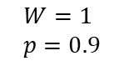
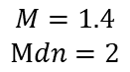
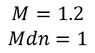
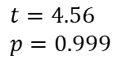
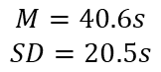
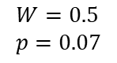
Hypotheses
Hypothesis 1
Hypothesis 2
Hypothesis 3
Save events (details view) <2 errors in average
Share an event in under 10 seconds
Remove event from "My Events"
<2 errors in average
Rejected
Rejected
Rejected
$$M=1.4$$
$$Mdn=2$$
$$M=40.6s$$
$$SD=20.5s$$
$$M=1.2$$
$$Mdn=1$$
Metrics
Metrics
Metrics
Wilcoxon test
t-test
Wilcoxon test
Count the number of errors in average
Time until user clicks the sharing CTA
Count the number of errors in average
$$W=0.5 \\ p=0.07$$
$$t=4.56 \\ p=0.999$$
$$W=1 \\ p=0.9$$
Notes:
Person 1

Slide 34
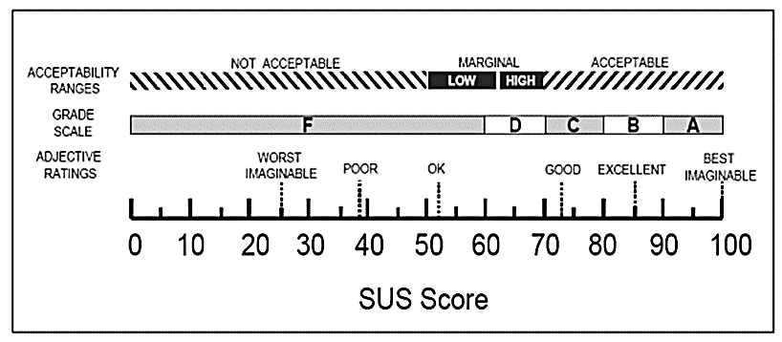
System Usability Scale
Score
Notes:
Person 1

Slide 35
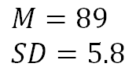
System Usability Scale
$$M=89 \\ SD=5.8$$
SUS Score: 89 – Best Imaginable
Score
Notes:
Person 1

Slide 36
User Experience Questionnaire
Mean score
Notes:
Person 1

Slide 37
User Experience Questionnaire
Scale | Mean | Comparison to benchmark
Attractiveness | 1.87 | Excellent
Perspicuity | 2.55 | Excellent
Efficiency | 2.08 | Excellent
Dependability | 1.65 | Good
Stimulation | 1.65 | Good
Novelty | 0.65 | Below Average
Notes:
Person 1

Slide 38
User Experience Questionnaire
Novelty improvements:
Creative – dull
Inventive – conventional
Usual – leading edge
Conservative – innovative
→ Adding innovative functionality & creative design
Notes:
Person 1

Slide 39
Discussion & Conclusion
Discussion & Conclusion
IPP 2022
Notes:
Person 1

Slide 40
Discussion
Hypotheses were not formulated optimally (perhaps too strict for the experimental set up)
UX and Usability improvements should be considered
Improve map icons and highlight search and filter options
Reconsider concepts for improving novelty

Slide 41
Conclusion
Human-Centered Design process great for adjusting and refining functionality regarding new insights (user tests)
Further benchmarking required for continuing this idea (apps with similar functions came to the market during our development process)
new technology and tools
interesting methods
great project, great fun, nice teamwork

Slide 42
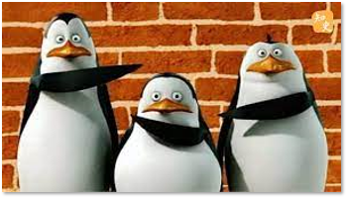
Thank you for your attention!
Questions?
www.fanpop.com
IPP 2022
Notes:
Person 1

Slide 43
Literature
Icons8. (o. D.). Icons8. Accessed at 7. Februar 2022, on https://iconos8.es/icons/set/evaluation
Interactionprototyping. (2021). TUM Interaction Prototyping. Accessed at 7. Februar 2022, on https://interactionprototyping.github.io/exercises_2.0/index.html
Fanpop - Penguins of Madagascar Club. (o. D.). Madagascar Fan Club Page. Accessed at 7. Februar 2022, on https://www.fanpop.com/clubs/penguins-of-madagascar/images/18270082/title/not-photo
Michael Ziegler. (2017, 5. September). Kinderserie Pingu bekommt Anime-Adaption. Sumikai Nachrichten aus Japan. Abgerufen at 7. Februar 2022, on https://sumikai.com/mangaanime/anime/kinderserie-pingu-bekommt-anime-adaption-188942/
Brooke, J. (1996). "SUS: a "quick and dirty" usability scale". In P. W. Jordan, B. Thomas, B. A. Weerdmeester, & A. L. McClelland. Usability Evaluation in Industry. London: Taylor and Francis.
Schrepp, M.; Hinderks, A. & Thomaschewski, J. (2014). Applying the User Experience Questionnaire (UEQ) in Different Evaluation Scenarios. In: Marcus, A. (Ed.): Design, User Experience, and Usability. Theories, Methods, and Tools for Designing the User Experience.
Notes:
Person 5: 30secs Stefano

Slide 44
Back Up
Back Up
IPP 2022
Notes:
Person 1

Slide 45
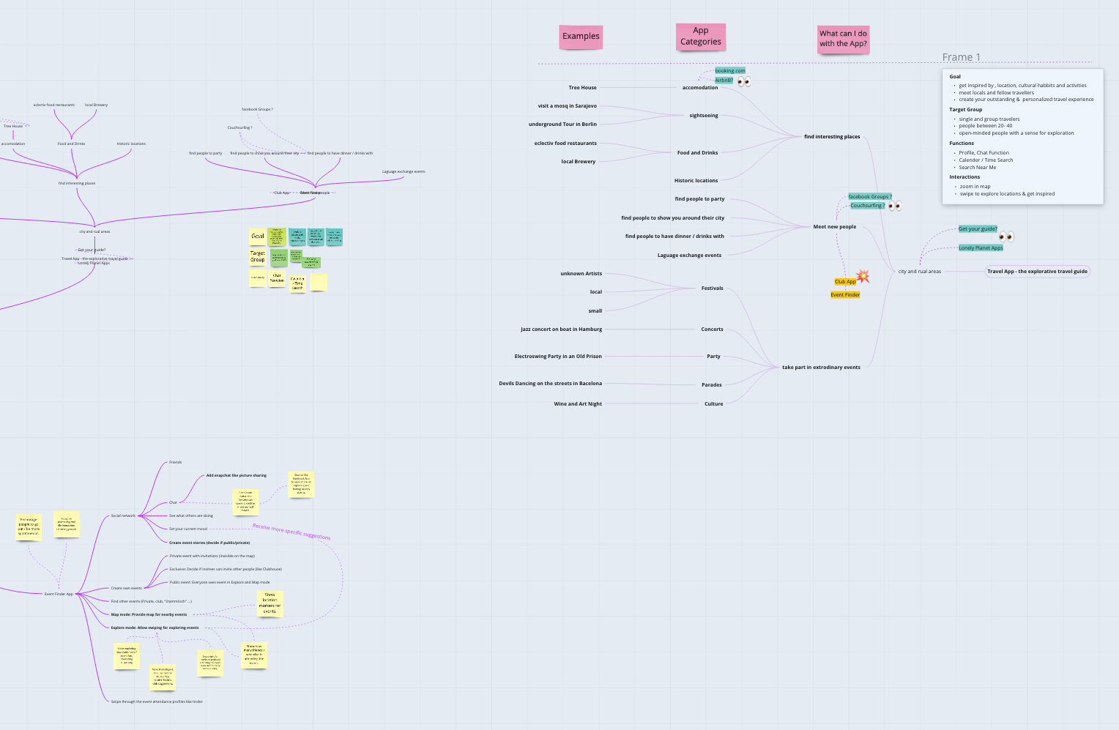
How it all started
Miro
Mind Map
Target User Group
Similarities and differences
Existing Apps
3 Ideas
Brain Storming
Chat function
Travel Mode
Event Finder App
Search near my
Mobile user
Open minded people
Swipe interaction
Profile
18-45 years
Find and create events
Map View
Attending Events
Notes:
Person 1

Slide 46
LoFi Paper Prototype
We looked into...
Young professional
Student
3 different Personas
Miro
Senior professional
We learned ...
Thinking aloud
Information Structure is partly misleading
Moderation of private events?
User Tasks
User Goals and Scenarios
Figma
Private vs. Professional events
Find right Event
Decide spontaneously
Wording Issues
Logic of Swipe Mode ?
Exploring events in the city
Users liked the available functions
Notes:
Person 1

Slide 47
HiFi Paper Prototype
We considered...
Feedback Iteration 1
Usability Requirements
Heuristic Evaluation
UML Use Cases
Competitor and similar Apps
We adjusted...
Notes:
Person 1

Slide 48

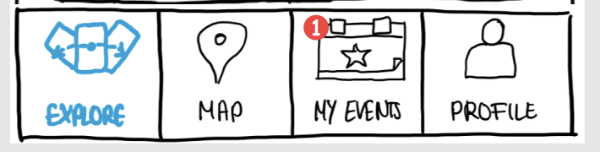
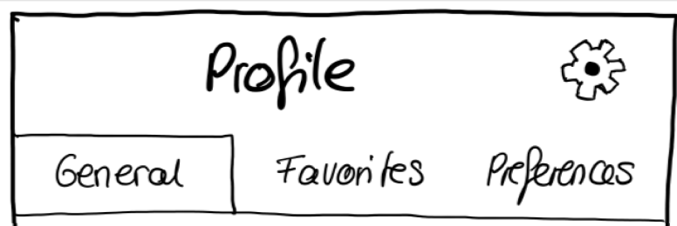
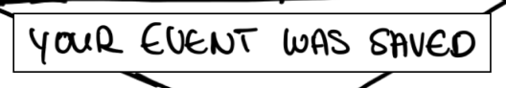
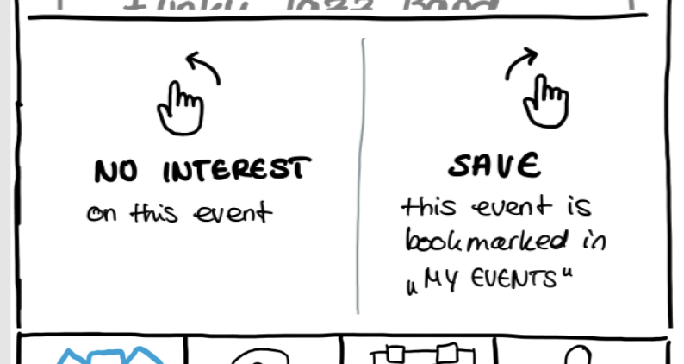
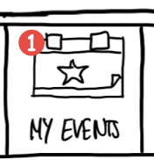
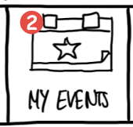

Lehrstuhl für Ergonomie TUM School of Engineering and Design Technical University of Munich
Link to Prototype
HiFi Paper Prototype – What´s New
Information Architecture and Wording
Meeting Requirements
System Feedback
Learnability and Memorability
Error Prevention
Vincent Brunner | Beatrice Seibert | Stefano Ferrari| Interaction Prototyping| Winter Semester 2021/2022
6

Slide 49

HiFi Prototype
We changed...
Qualitative Evaluation
We designed...
User tested
Familiar to user
Intuitive UI
Assures readability and accessibility
Notes:
Person 1

Slide 50
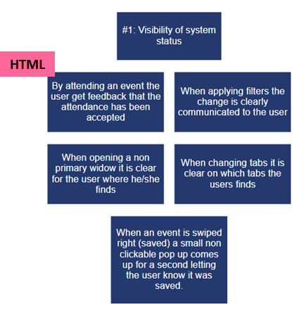
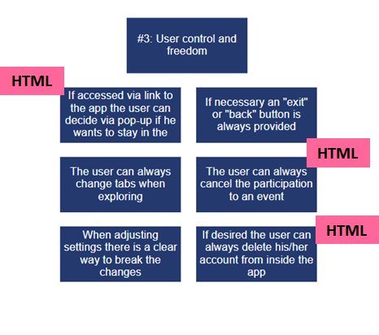
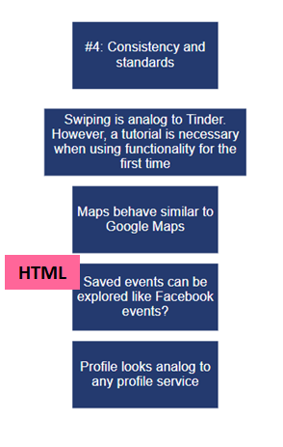
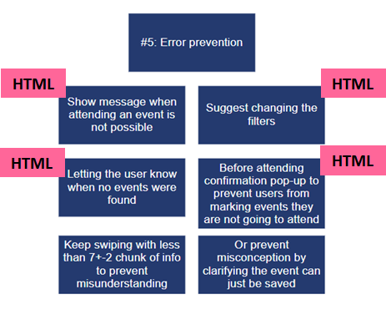
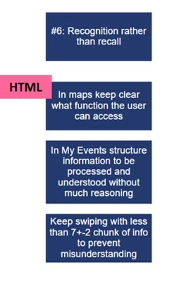
Lehrstuhl für Ergonomie TUM School of Engineering and Design Technical University of Munich
Why?
- Discover usability problems with individual elements and how they impact the overall user experience.
- To further identify and understand problems.
Heuristics Analysis
Results:
Vincent Brunner | Beatrice Seibert | Stefano Ferrari| Interaction Prototyping| Winter Semester 2021/2022
4

Slide 51
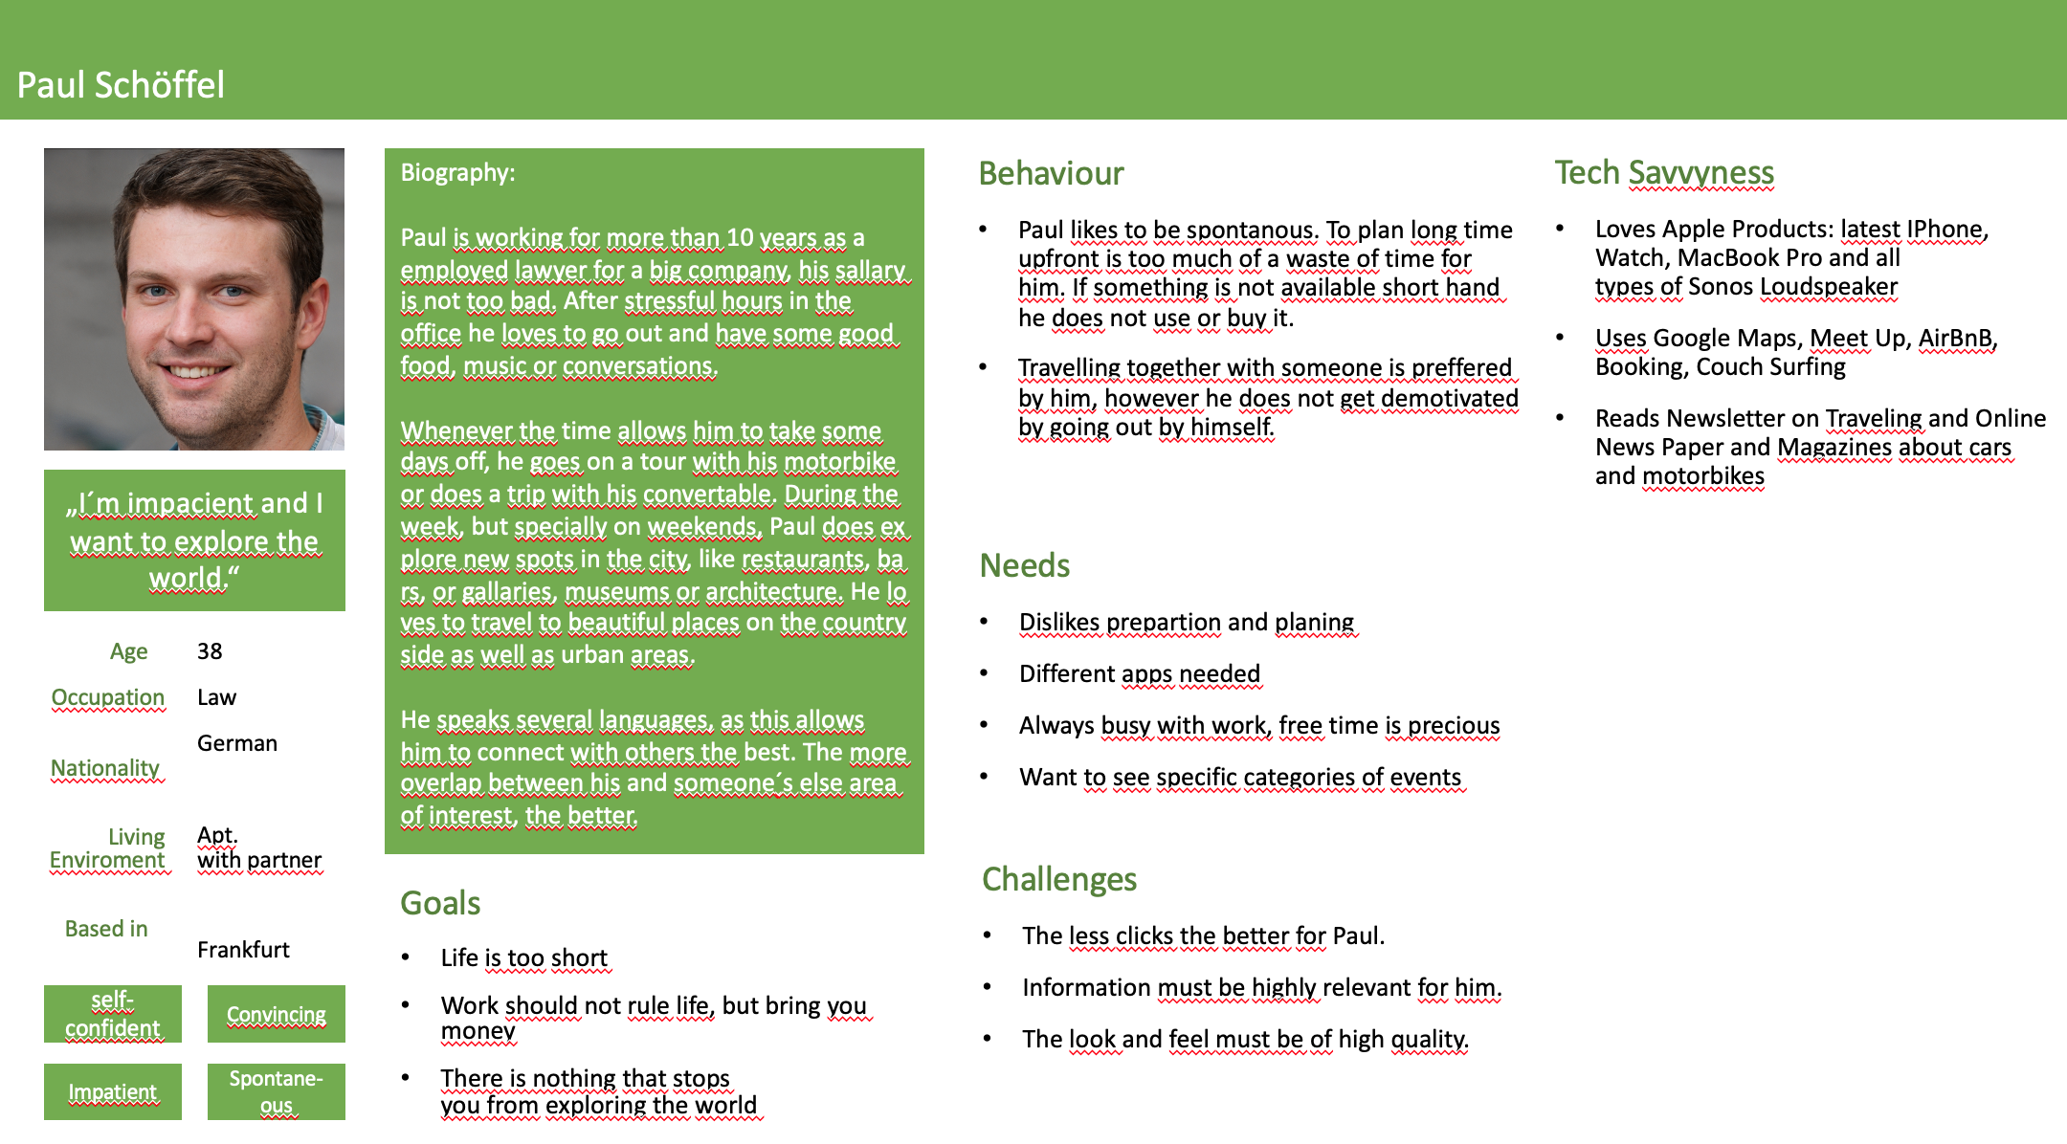
Personas

Slide 52
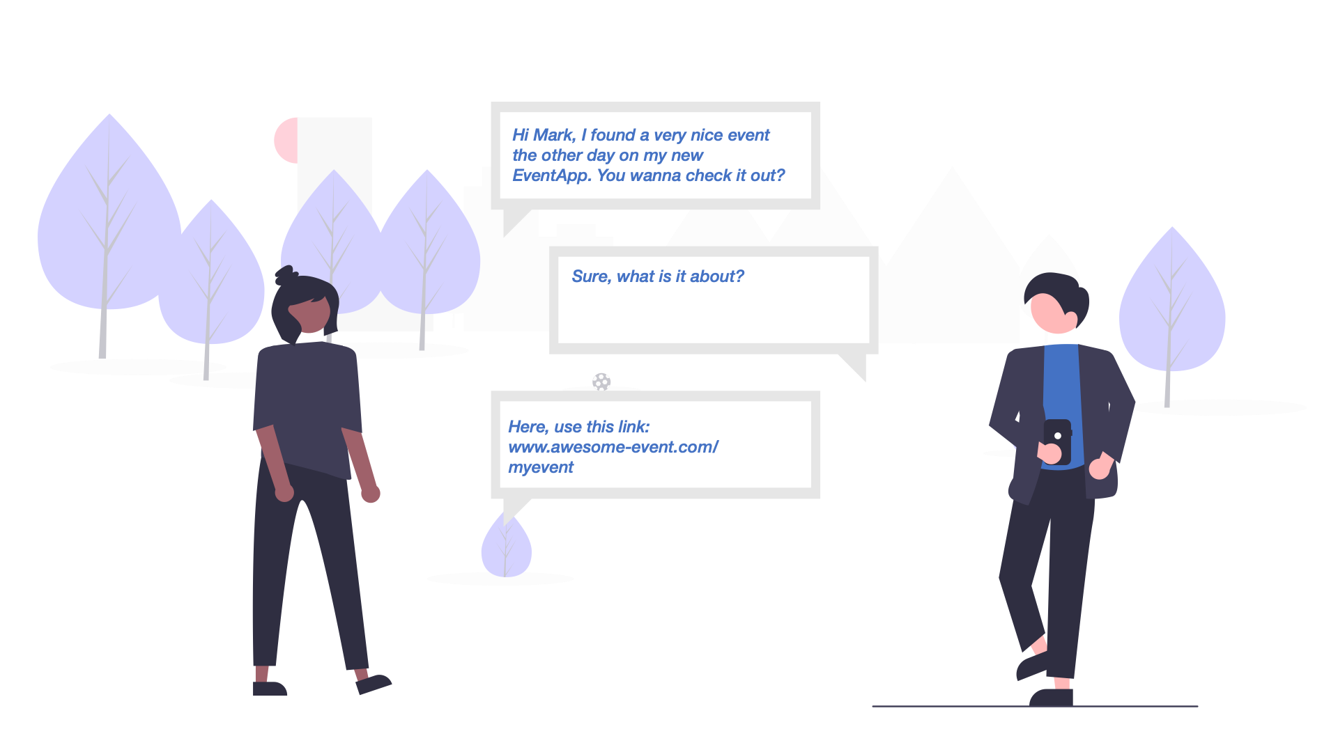
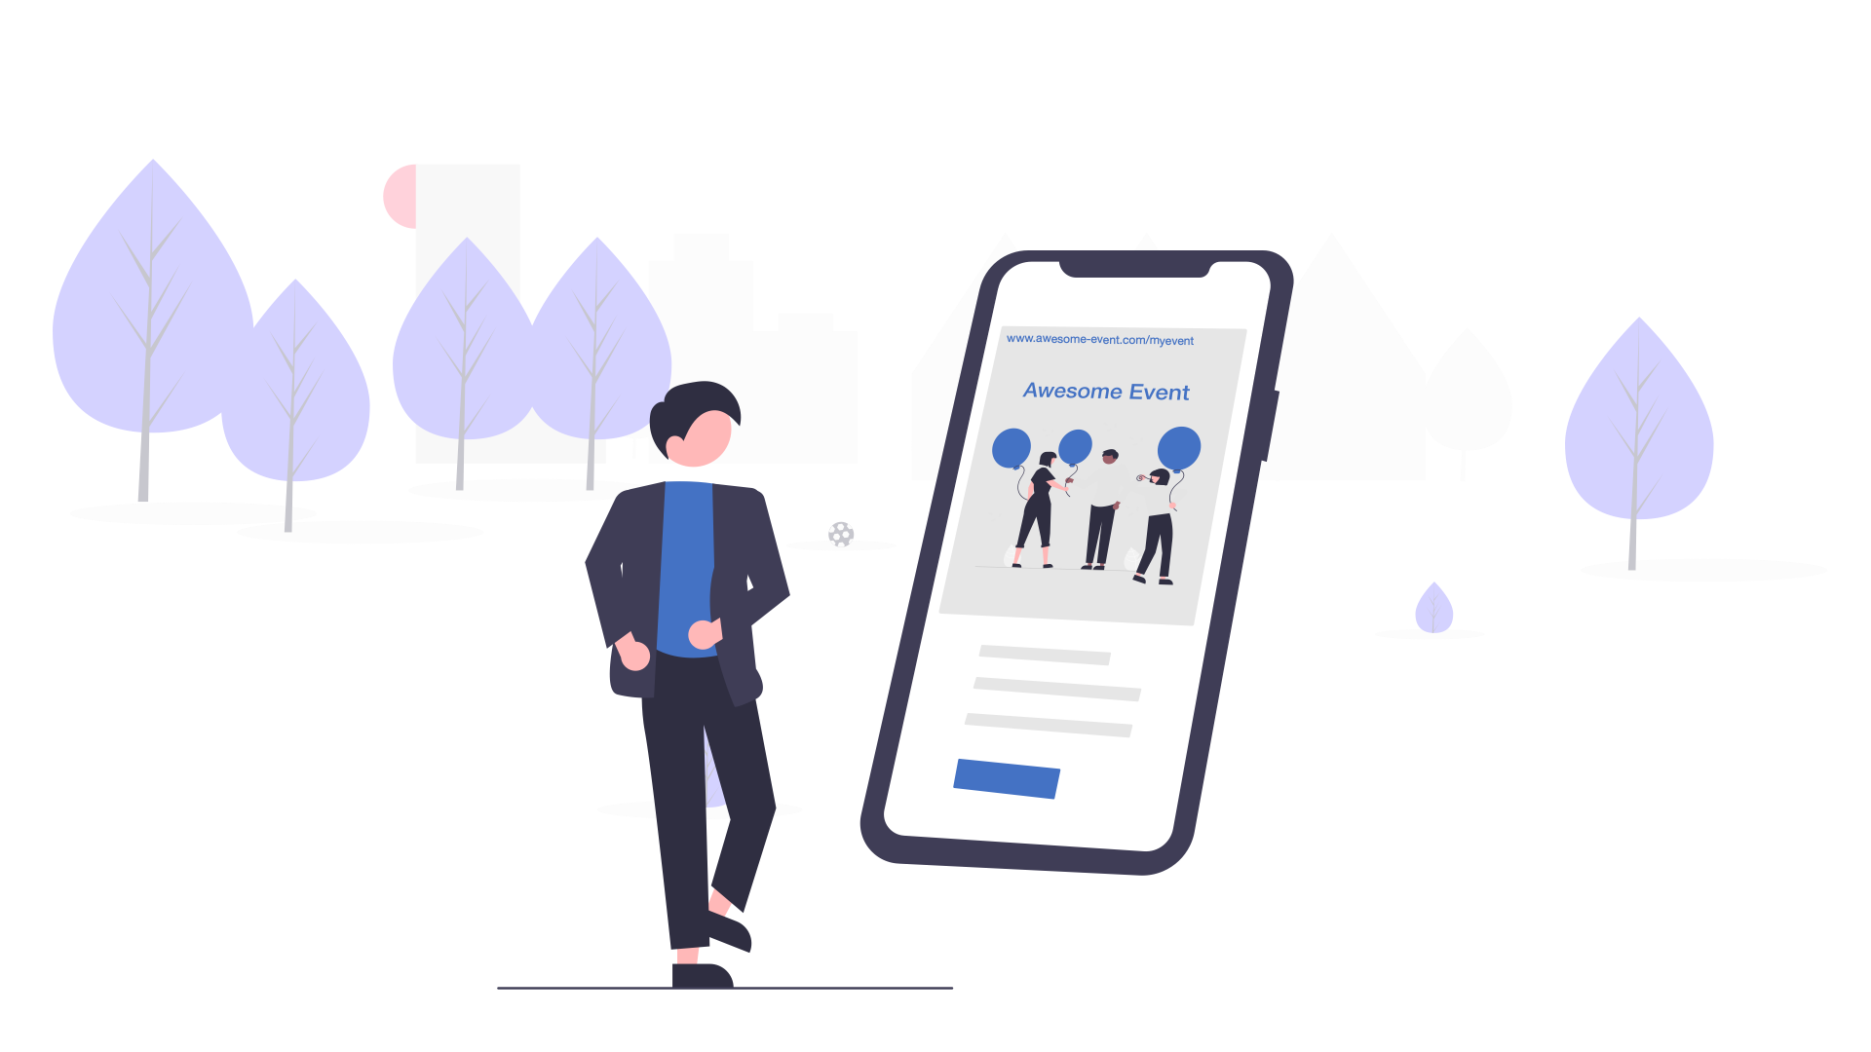
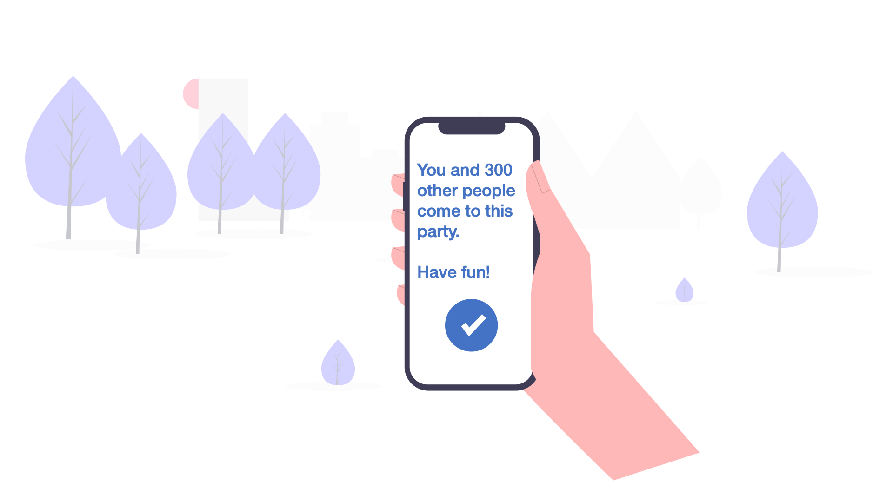

Story Boards

